Slide 1
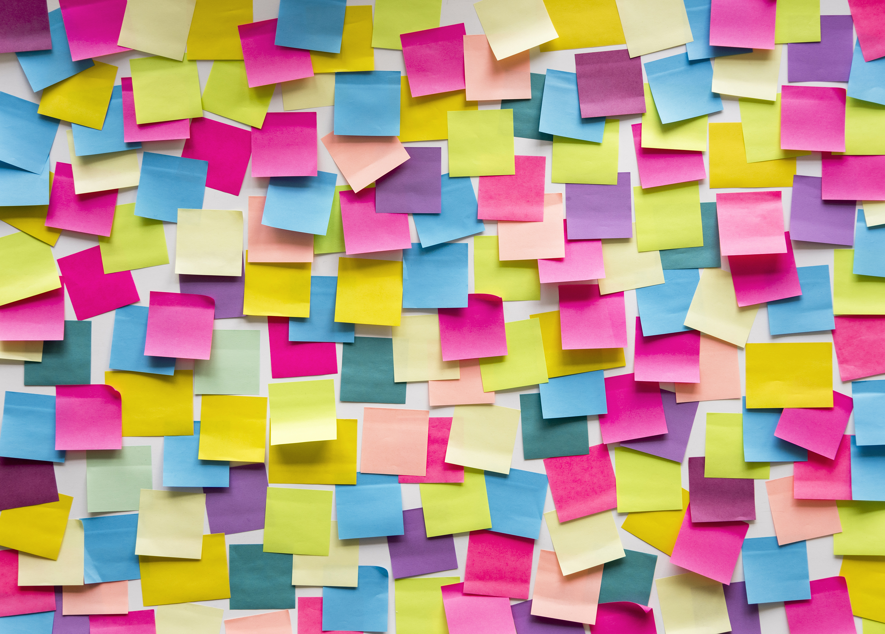






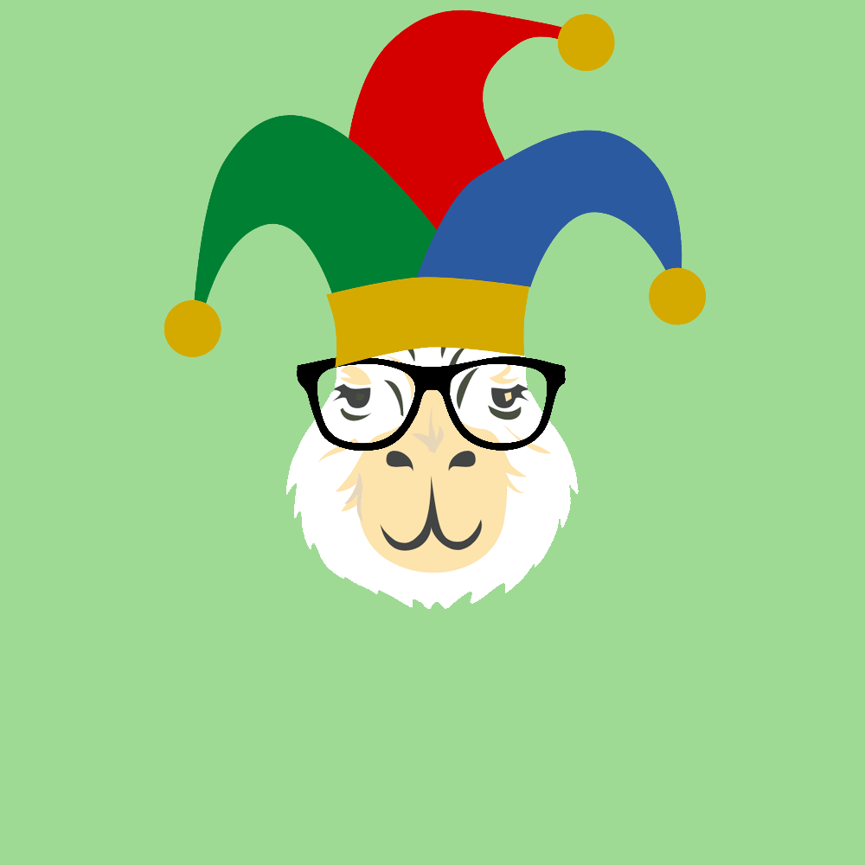

NFTs
And Our Journey To The Creation Of The Cryptobara Collection
A project by: Marcela Castano Rina Weiner Frank Lau Monique Ferguson

Slide 2
Overview
Let’s make an NFT!
Artistic Development
Pinata and IPFS
Smart Contract
Minted Cryptobara Collection & Dapp

Slide 3

Wait, what’s an NFT?
Did you know that NFT was Collins Dictionary Word of the Year 2021?

Slide 6
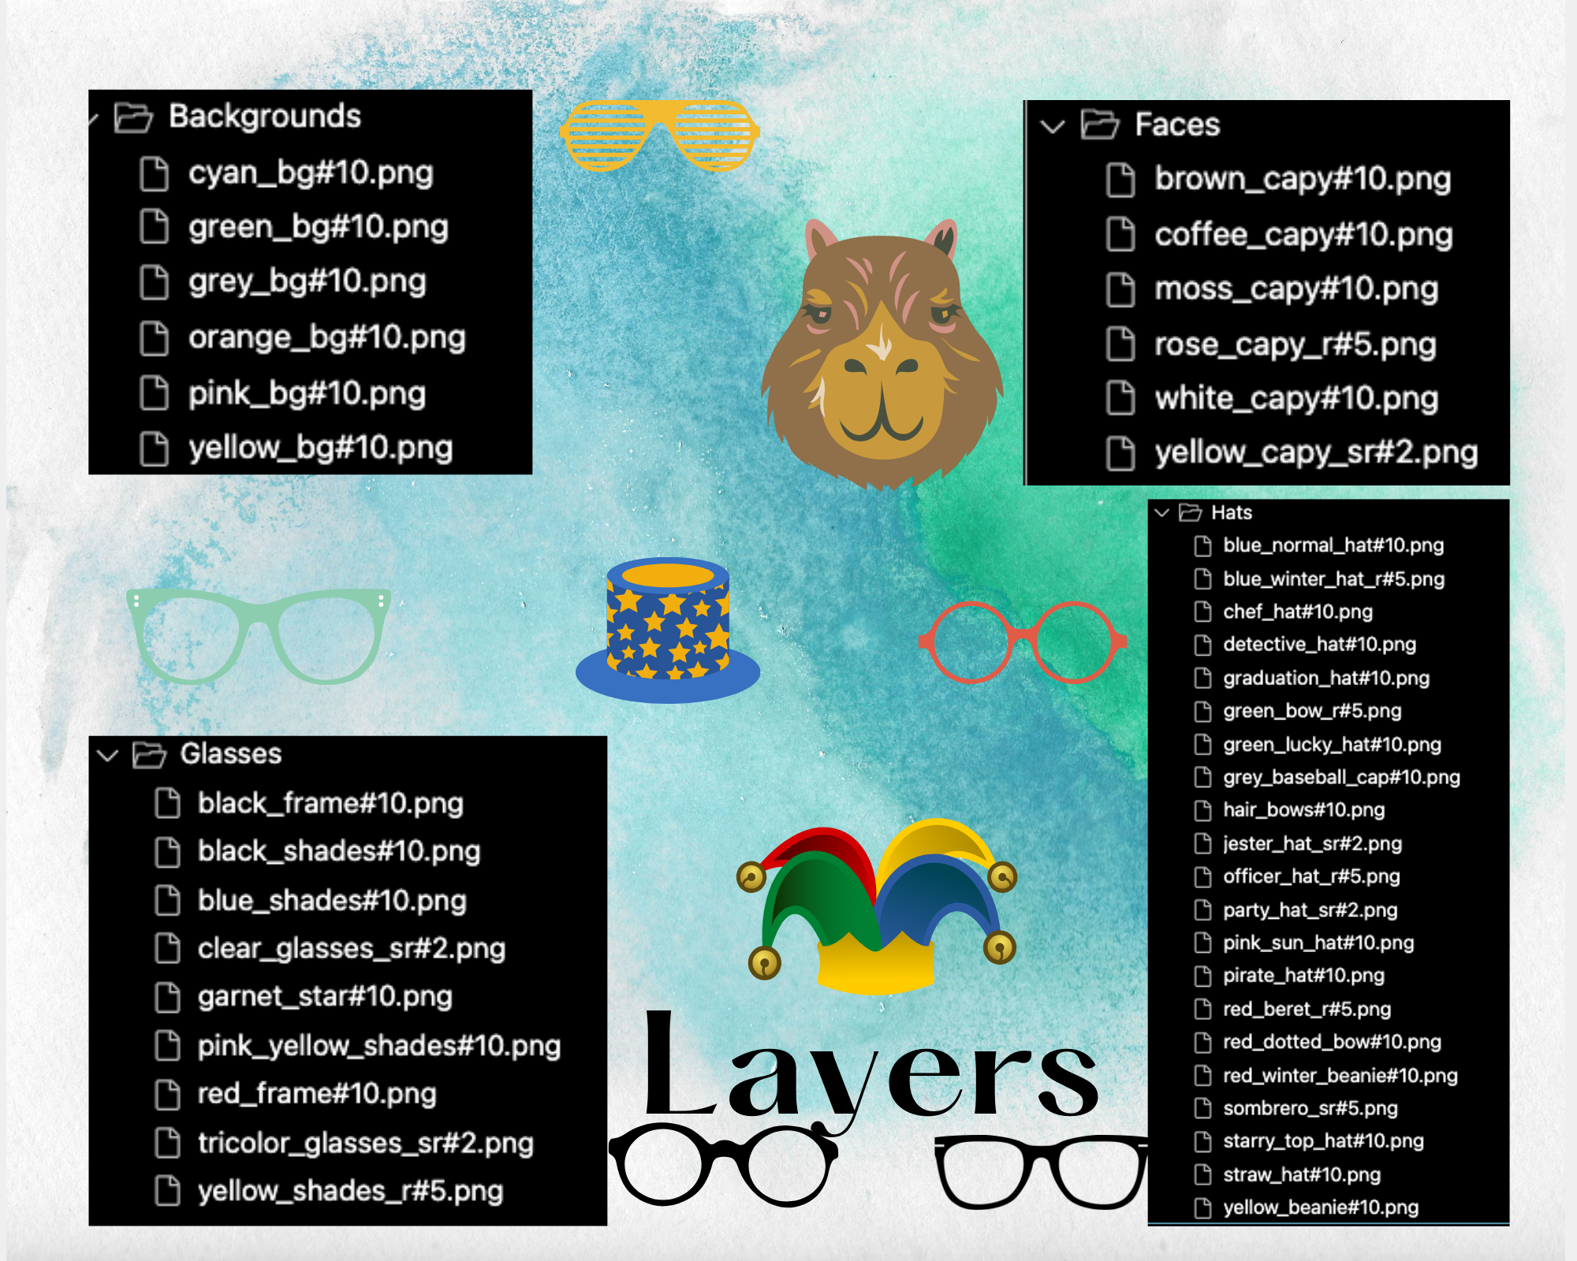
Layers

Slide 7
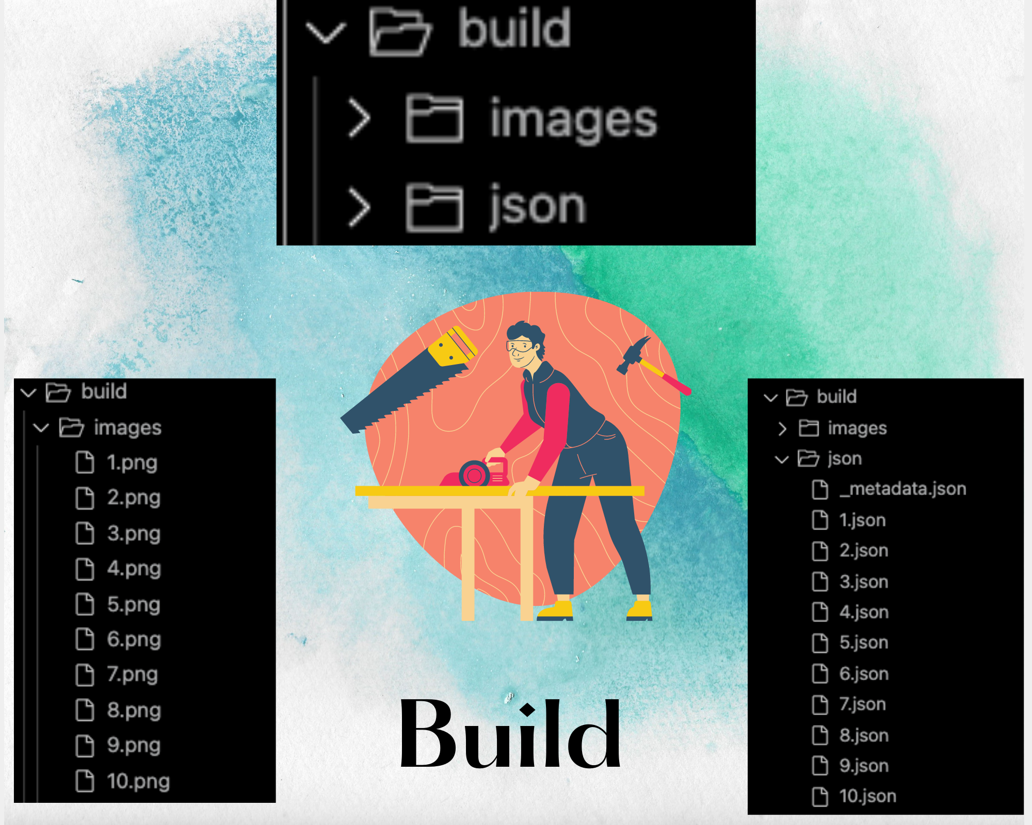
Build

Slide 8
Preview Images

Slide 9
Pixelated Images

